Slide 1
Superior Customer Experience As Your Competitive Advantage
Puneet Sharma
Business Manager – ASEAN
Service Cloud
Salesforce
Notes:
It’s awesome to be here today and speak to you all about how you can improve customer satisfaction and revenue through improved customer experiences. I’ve been with Salesforce for 4 years now, and as a Customer Experience specialist I get to work with all sorts or organisations, large and small to help them on their journey to transform their customer experiences. I get to see everything on the spectrum, from people using manual paper based solutions, through to more advanced organisations looking to take the next step on their journey.
But you know what? We are all customers. We all have our own experiences to draw upon – we deal with it everyday. So as we step through the webinar today, and 3 key areas to help boost revenue and customer satisfaction, start jotting down anecdotes from your own experiences – as a customer of whoever you are dealing with – what would make YOU as a customer happier? What would make you buy more, or renew, or stay with that company. In your own experiences there will be nuggets of gold of how you change the customer experience for your own customers.
We also have a great long-term Salesforce customer who will share their experience of transforming their customers experiences and the impact it’s had on their business.

Slide 2

Forward-Looking Statements
Statement under the Private Securities Litigation Reform Act of 1995:
This presentation may contain forward-looking statements that involve risks, uncertainties, and assumptions. If any such uncertainties materialize or if any of the assumptions proves incorrect, the results of salesforce.com, inc. could differ materially from the results expressed or implied by the forward-looking statements we make. All statements other than statements of historical fact could be deemed forward-looking, including any projections of product or service availability, subscriber growth, earnings, revenues, or other financial items and any statements regarding strategies or plans of management for future operations, statements of belief, any statements concerning new, planned, or upgraded services or technology developments and customer contracts or use of our services.
The risks and uncertainties referred to above include – but are not limited to – risks associated with developing and delivering new functionality for our service, new products and services, our new business model, our past operating losses, possible fluctuations in our operating results and rate of growth, interruptions or delays in our Web hosting, breach of our security measures, the outcome of any litigation, risks associated with completed and any possible mergers and acquisitions, the immature market in which we operate, our relatively limited operating history, our ability to expand, retain, and motivate our employees and manage our growth, new releases of our service and successful customer deployment, our limited history reselling non-salesforce.com products, and utilization and selling to larger enterprise customers. Further information on potential factors that could affect the financial results of salesforce.com, inc. is included in our annual report on Form 10-K for the most recent fiscal year and in our quarterly report on Form 10-Q for the most recent fiscal quarter. These documents and others containing important disclosures are available on the SEC Filings section of the Investor Information section of our Web site.
Any unreleased services or features referenced in this or other presentations, press releases or public statements are not currently available and may not be delivered on time or at all. Customers who purchase our services should make the purchase decisions based upon features that are currently available. Salesforce.com, inc. assumes no obligation and does not intend to update these forward-looking statements.
Notes:
Key Takeaway: We are a publicly traded company. Please make your buying decisions only on the products commercially available from Salesforce.
Talk Track:
Before I begin, just a quick note that when considering future developments, whether by us or with any other solution provider, you should always base your purchasing decisions on what is currently available.

Slide 3
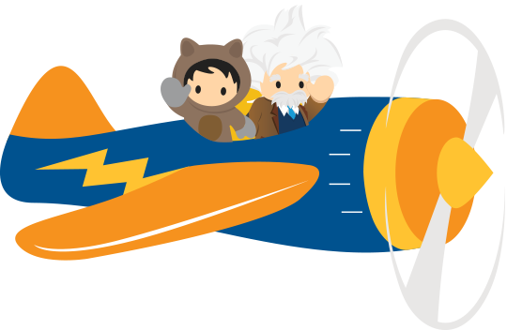




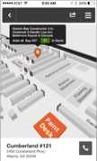
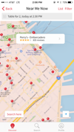



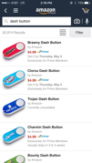

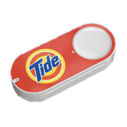

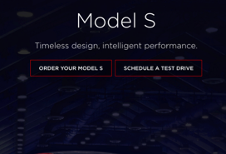


This World Has Reshaped Customer Expectations
SMART
ANYWHERE
“Know what I want.”
“I want it where I am.”
FAST
“Connect every
experience to me.”
“I want it now.”
CONNECTED
Notes:
We live in a fascinating time. Today's on-demand world is changing how we interact with companies. Fast: One of my least favorite activities is buying a car. You have to take the time to understand complex features, confusing options, and haggling for hours over price. Now, you can learn about, configure, and even buy the most technologically advanced car in the world from an iPad. Tesla’s process is fast and easy. Smart: Consumers also expect intelligent, tailored experiences. I recently moved into a new home, so I’ve become a regular at Home Depot, which can be daunting maze trying to find what you need. Thankfully, Home Depot has designed an app that shows you exactly where items on your shopping list are located within your preferred store and draws out a map to find the items in the most efficient way. Anywhere: Smartphones have enabled companies to create experiences that make everything local and accessible wherever the customer is. One of my favorite apps is OpenTable, which has created an ecosystem of restaurants that show available reservations at thousands of restaurants around the world, and with a tap customers can reserve a table in the city that they’re located. Connected: I also couldn’t live without Amazon. Amazon has trained consumers to expect that they can find and order any product in the world on its website. Now, Amazon has introduced its "Dash" service to automatically order groceries and household supplies with the touch of a button connected to its ecommerce engine. Whether it's in the B2C or B2B worlds, customers are coming to expect a much higher, more personalized level of customer experience.

Slide 4

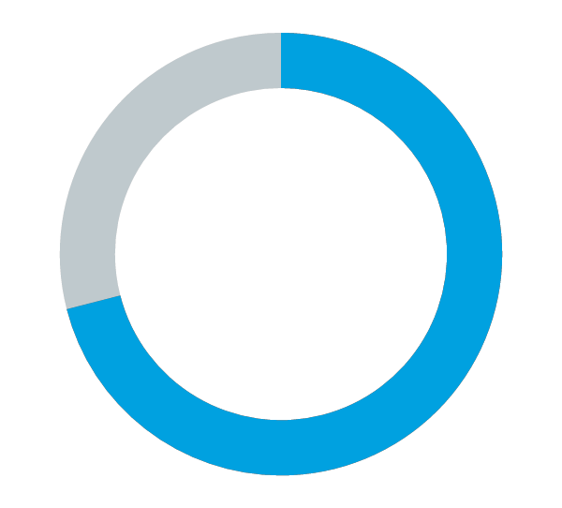

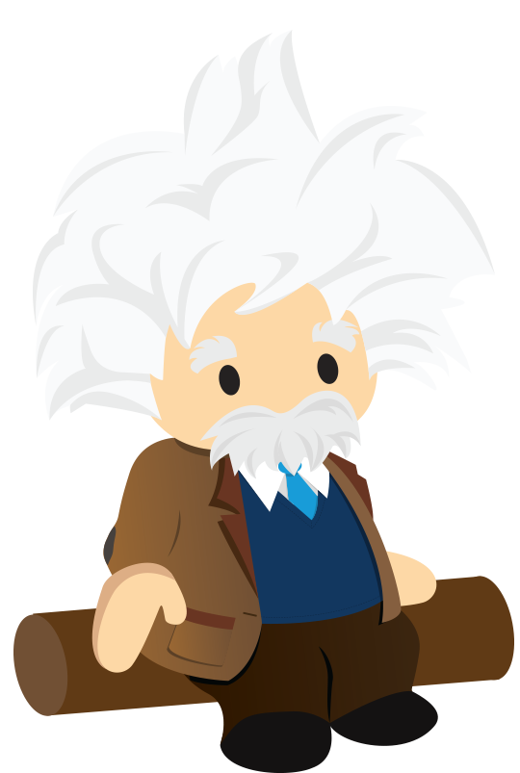
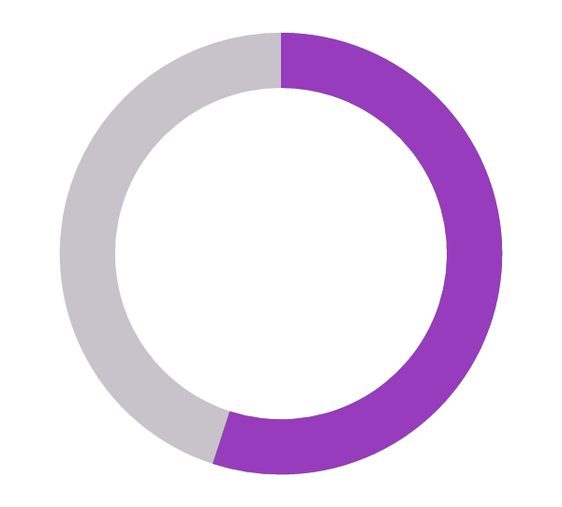

Customer Experience is the New Battlefield
Slow replies and inaccurate information are customers’ main complaints
71%
Stop doing business with the company
55%
Complain to family and friends
The Economist Intelligence Unit
Notes:
So today, things like responding quickly and providing consistent and accurate information are expected, and the stakes are high--when companies don't deliver, nearly three-quarters of customers will stop doing business with the company, and over half will go one step further and complain about the company to family and friends. So providing a good customer experience is no longer a luxury. This is something companies must do to stay competitive. Customers will do business with the company that provides the best customer experience.
Source: https://www.eiuperspectives.economist.com/sites/default/files/Creating%20a%20seamless%20customer%20experience.pdf

Slide 5
But, What All does Come Under Customer Experience Delivery ?

Slide 6
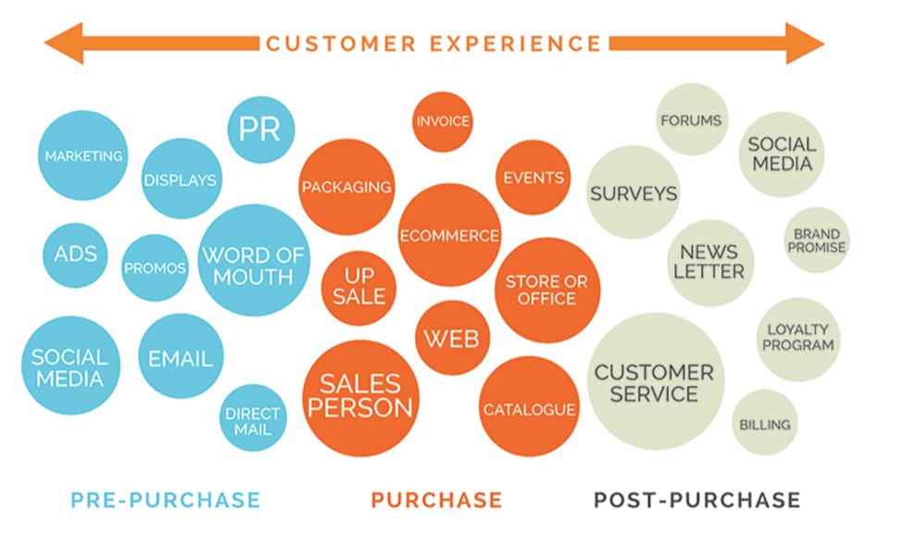
But, What All does Comes Under Customer Experience Delivery ?

Slide 7
And.. Who Owns Customer Experience Delivery ?
Customer Service ?
Marketing ?
Sales ?
Strategy ?
Marketing Agency ?
Design / Web / eCommerce Team ?

Slide 8




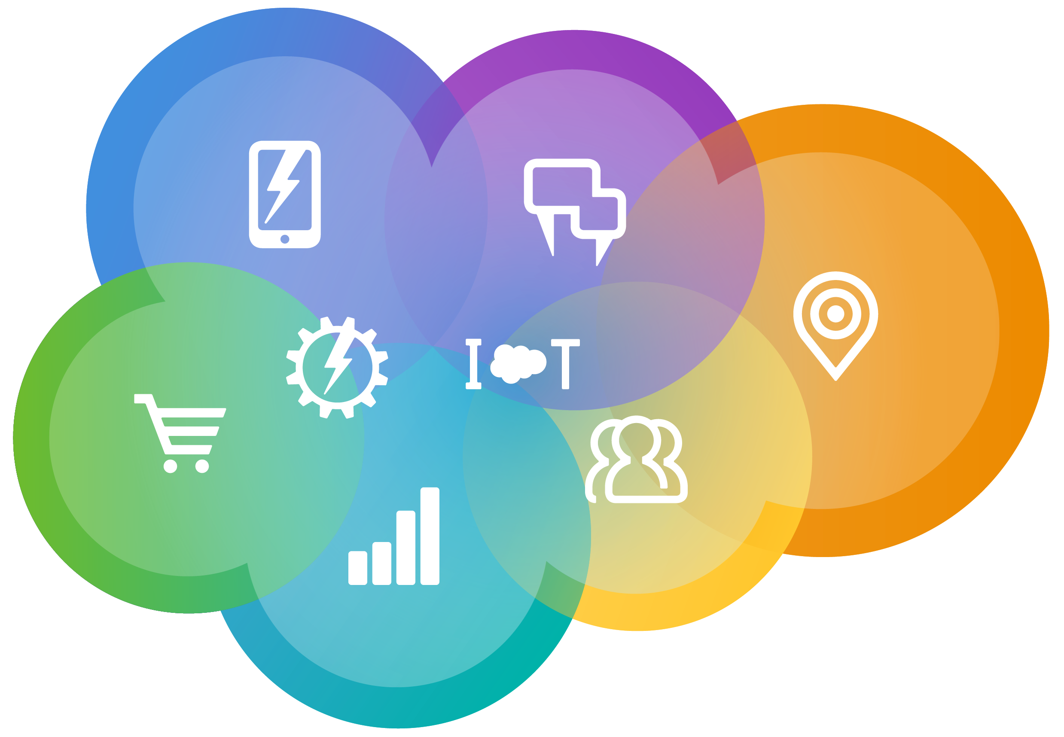

3 Ways to Boost CX, Uplift CSAT and Revenue
Contextual
Convenient & Effortless
Connected
Personalize every conversation and journey
Empower Customers with Intelligent Self-Service
Single Platform for every interaction
Notes:
Today, I want to focus on helping you get the basics right, drilling into 3 key areas that we know from experience, WILL help you boost CSAT and revenue.
Firstly, we will talk about contextual service and how to make sure EVERY single conversation is a personalised one, based on that customers journey with you. But when we talk about personalisation, we also talk about making sure that conversation is happening on a customer’s channel of choice.
We will also talk about convenience – and how to empower your customers to self-serve. We heard just on the last slide that 81% of people would prefer to do this before contacting you directly, so it’s important to have a strategy around seld-service options.
Lastly, Connected Service is critical. Connected means bringing everything together into a complete 360 degree view of the customer. This provides context around the customer at every touchpoint – no matter what the interaction is.
So, I challenged you to think of your own experience. Now, let me share mine. I recently returned from a holiday in Thailand. Now, how did I even book this in the first? I had previously booked with this travel site, and they know that I have a family with two young kids, so I got a targeted email (as well as Facebook posts) suggesting appropriate locations.
Like anything, I researched the offer that was provided, reviews etc on 3rd party sites. Right from this point, whether they like or not – I am a customer of this travel deal company!
So how was is personalised? I commute and do a lot of stuff on my phone. I was able to research, review and book the deal sent to me all via my phone – this is my preferred way of communicating – I spoke to no one during the entire end to end booking process.
It was super convenient – I had my own login to their member site, so at any time on the trip or before, I could access all of the booking details and what was included.
And it was definitely connected. I sent an email half way through the trip as I had a question about a certain inclusion. They responded quickly and appropriately – they didn’t have to ask who I was, what trip I was talking about or anything else – they knew, as their backend systems are connected to provide a single view of me as a customer.
But was is perfect? Well, it was close, but there are small things that could have made the experience even more amazing? I.e. why couldn’t I search and find the information about the inclusion myself? This would save the travel company and myself more time?
Why couldn’t I do this via a live chat to get an immediate answer?
So there’s a great example of excellent service, and why Contextual, Convenient and Connected service were all such critical pieces of making me a happy customer. Will I rate that experience highly? Absolutely! Will I use that company again – for sure!!! That’s boosting CSAT and Revenue for that travel company in action!

Slide 9
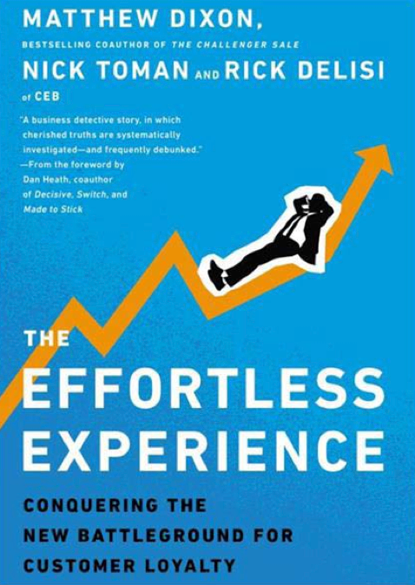
The Effortless Experience Conquering the new Battleground for Customer Loyalty
Finding #1 – delighting customers doesn’t pay
Finding #2 – customers prefer to self-serve
Finding #3 – customer service interactions tend to drive disloyalty, not loyalty
Finding #4 – the key to mitigating disloyalty is reducing customer effort
Most customers don’t want to be “wowed”; they just want an effortless experience.

Slide 10
FINDING 1: DELIGHT DOESN’T PAY
More Loyal
Less
Loyal
Below Customer Expectations
Meets Customer Expectations
Exceeds Customer Expectations

Slide 11
FINDING 1: DELIGHT DOESN’T PAY
The Perception
More Loyal
Less
Loyal
Below Customer Expectations
Meets Customer Expectations
Exceeds Customer Expectations

Slide 12
FINDING 1: DELIGHT DOESN’T PAY
The Perception
More Loyal
The Reality
Less
Loyal
Below Customer Expectations
Meets Customer Expectations
Exceeds Customer Expectations

Slide 13
FINDING 1: DELIGHT DOESN’T PAY
The Perception
More Loyal
The Reality
Less
Loyal
Below Customer Expectations
Meets Customer Expectations
Exceeds Customer Expectations
“Delight” only happens 16% of the time
“Delight” increases operating costs 10-20%

Slide 14


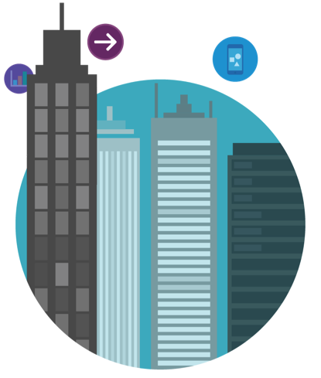


Why Effortless Experience : Today, Customers Avoid Support
Getting support is painful, time consuming, and inconvenient
Let me transfer you to one of our specialists. Can you hold?
Hello, who am I speaking with?
Can you hold while I look something up, please?
Have you tried following our troubleshooting instructions?
How can I help you today?
Can you tell me about your problem?
81%
Which product are you calling about?
of customers would prefer to self-serve before dealing with a service agent
Source: HBR
Notes:
So let’s just get it out there. Today, the reality is that customers avoid support. It’s required when something goes wrong.
It’s treated like a tax you have to pay for doing business -- and worse -- it’s a tax your customers have to pay for engaging with you! So what do they do? They avoid contacting you. In fact, 81% of customers try self-service options before contacting support.
That’s because getting support is painful, time consuming and inconvenient. Think of all the repetitive questions you’ve been asked while calling in to a contact center. With all the technology available, shouldn’t companies that you do business with know who you are already and what your preferences are?
So, a question for you all to jot down an answer to after this webinar. We are all customers. Think about the last touch point you had with a company. Was it a good or bad experience? What are 3 things that made it good or bad? And were you after help, or were you looking to buy a product or service?
Source: HBR https://hbr.org/2017/01/kick-ass-customer-service

Slide 15



And Continuous Technology Innovation Made Delivering a Great Customer Experience Difficult
Disconnected Systems, Departments, Locations…
Poor Customer Experience
No Visibility into Customer Needs
Loss of Productivity
Unreliable Customer Information
Notes:
The problem is that customer experience is hindered by disconnected systems. 1: When sales & service don't talk to each other, it's hard to know what the customer really needs because the information is in two separate places and doesn't flow together. 2: This also affects the productivity of your sales reps and service agents, because it's harder to collaborate and learn from each other, and they spend more time chasing things down. 3: Perhaps worst of all, disconnected systems result in unreliable customer information. This all leads to a poor customer experience, which as we've seen often means the customer stops doing business with you altogether and may even complain to family and friends.

Slide 16

Consistent Engagement & Service Leads to Loyalty
69%
Today’s Challenges can be Tomorrow’s Opportunity
Contextual
of consumers say personalized care influences their loyalty
Personalize every service conversation As Your Competitive Advantage
Source: “State of the Connected Customer,” Salesforce Research, October 2016
Notes:
With Salesforce for Service, you can deliver personalized service conversations to every customer across every channel.
We know that 69% of consumers say that personalized care and service influences their loyalty, so enabling our customers to deliver 1-to-1 engagement across every touchpoint is vital.

Slide 17
So what’s next?

Slide 18
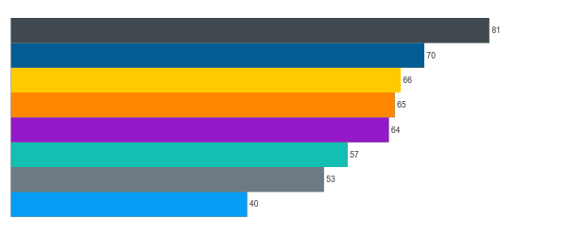
What We Have Heard – Top Strategies for Business Leaders
Near term goals (12 – 24 months)
Technology Innovation
Customer Retention
Cost Reduction
Improve Product / Service Quality
Grow Number of Customers / Leads
Organisational Stability
Talent Attraction
Talent Retention

Slide 19
Strategic Priorities for Asian Emerging Markets
Key attributes comparison against developed markets
Key attributes comparison | Emerging markets | Developed markets
Technology innovation has changed the way my company operates in a positive manner | 79% | 73%
Technology innovation is the top priority in the next 12-24 months | 65% | 51%
Technology innovation is most valuable in creating better customer support | 42% | 31%
Adoption of CRM system | 51% | 34%
Likelihood to adopt AI CRM platform | 84% | 66%
Key takeaways
Asian markets are more likely to
agree technology has a positive impact on their company
prioritise technology innovation in their company’s near-term plans to enhance customer support
adopt CRM and the Artificial Intelligence CRM platform

Slide 20







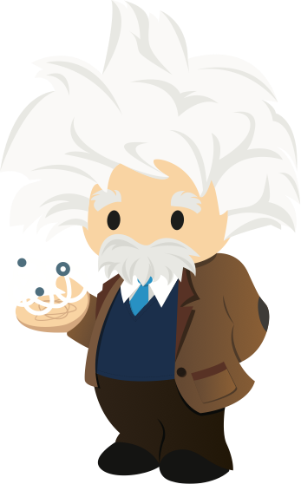
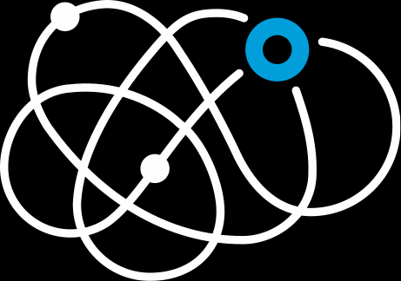



Where are you at & What to Aim For…
“We need to transform!”
“Need to be more efficient!”
“Just give us the basics!”
Service Journeys
Connected Products
Intelligent Routing
Intelligent Self-Service Communities
Messaging
Agent Single View & Tools
Automated responses/Service Bots
Embed Support In App
Knowledge
Cross-sell & Upsell
Self-Service
Field Service
Service Analytics
Social Customer Service
Phone, Email, Web
Notes:
So I had an experience with a company that provides great service, that could have been even slightly better, but bot everyone is even at that point yet.
So first up, before we delve too deep, I want to ask you a question. Be honest in your own appraisal – where do you think your organisation is at today? The good and bad news is, that no matter where you believe you are at – you are NOT done ☺ The transformation journey doesn’t stop.
And maybe you have some of the basics and some advanced capabilities today as well, based on your organisations own unique needs – that’s great as well.
While we are focussing in today on 3 key themes, underlying these, there are a range of capabilities that will help you transform.
I speak to a LOT of organisations today that are looking at advanced capabilities such as Connected Products and even Service Bots, but are yet to the foundational basics right, such as a great agent single view, self service and the ability to respond across fundamental channels such as phone, and email.
So keep this in mind as well – this is not a big bang approach to transform the customer experience!

Slide 21






























With Salesforce, Our Customer Trailblazers are Redefining Customer Success
+35%
Customer
Satisfaction
+31%
Faster Case
Resolution
22%
Cost
Savings
+28%
Agent
Productivity
Source: Salesforce Customer Relationship Survey conducted 2014-2016 among 10,500+ customers randomly selected. Response sizes per question vary.
Notes:
We work with companies across every industry and company size. This includes small customers like Yeti who makes high end coolers and global brands like General Electric.
One thing these customers all have in common is 100% focus on their customers. And what our customers are accomplishing is nothing short of amazing.
•They are driving costs out of the call center – +22% cost savings
•They are getting retaining their customers – +26% customer retention
•They are making their agents much more productive – +28% agent productivity
•They are getting answers to their customers faster – +31% faster case resolution
•They are making their customer happier - +35% customer satisfaction
We’re constantly amazed by how our customers are redefining success.

Slide 22
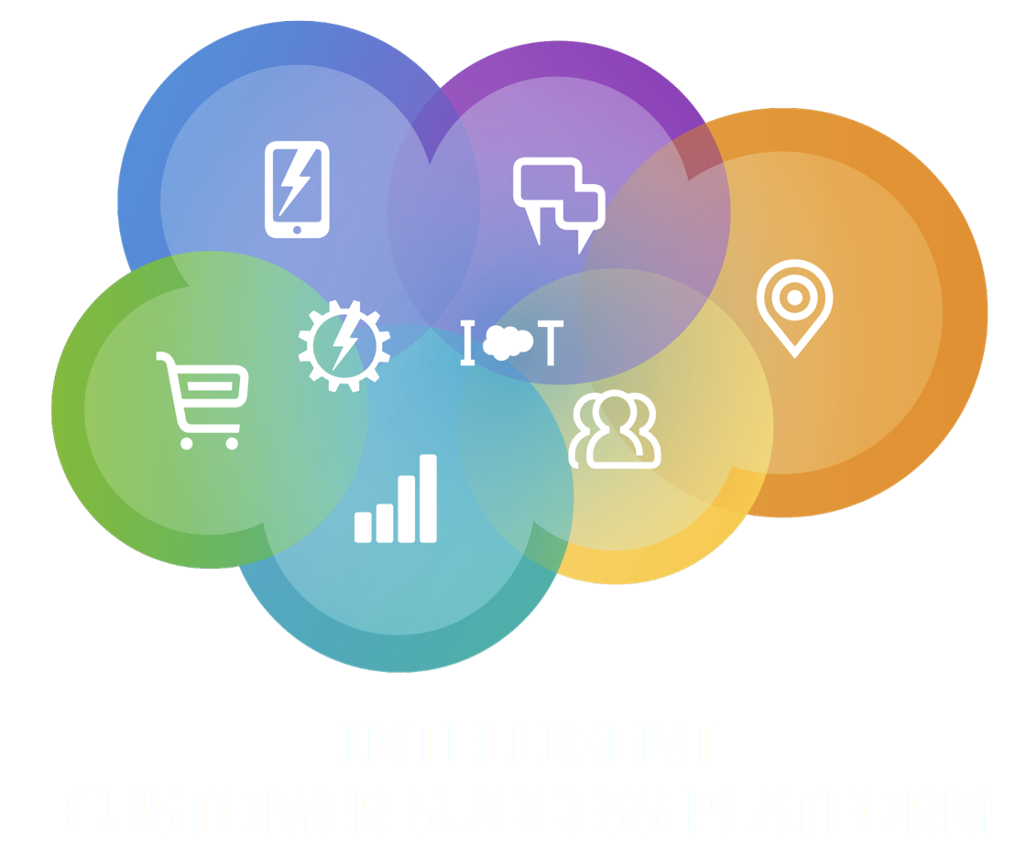
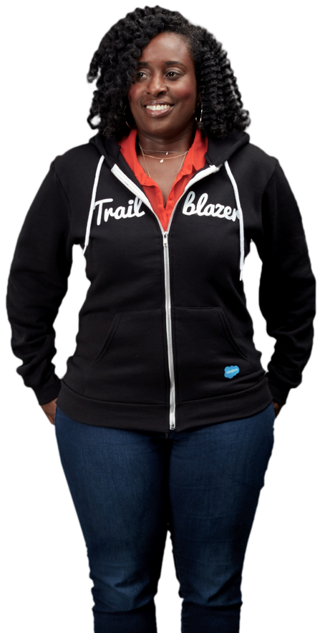

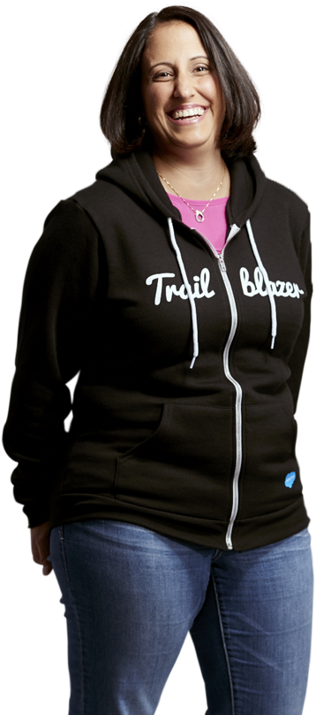
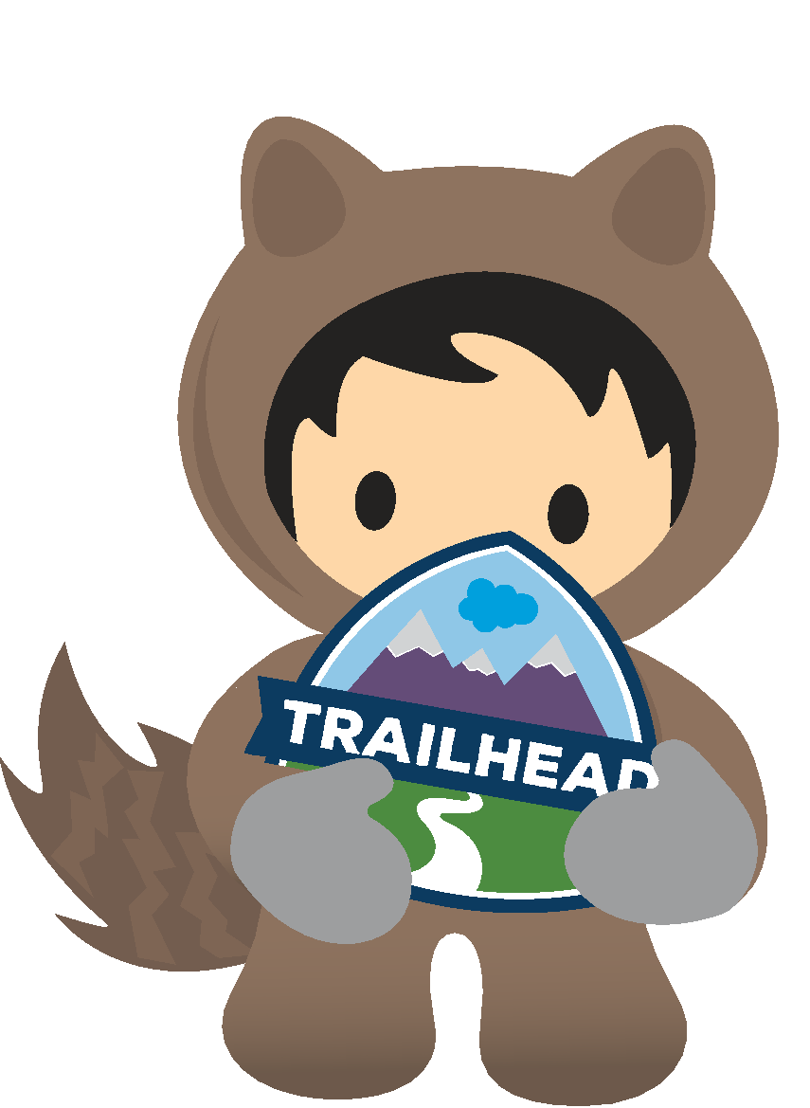




A Single Platform for Connecting with Customers
Connect to your customers in a whole new way
Notes:
At Salesforce, we empower companies to harness data and deliver the connected experiences customers expect with the Customer Success Platform. It's a single platform to to intelligently connect and engage customers across Sales, Service, Marketing, Communities, Analytics, Commerce, IoT and custom Applications. The Salesforce Customer Success platform allows you to connect to your customers in a whole new way. Key Message
We provide everything for you to achieve a new kind of customer success.
We have a single platform that can connect your entire business, so you can get a 360 degree view of your customer.

Slide 23
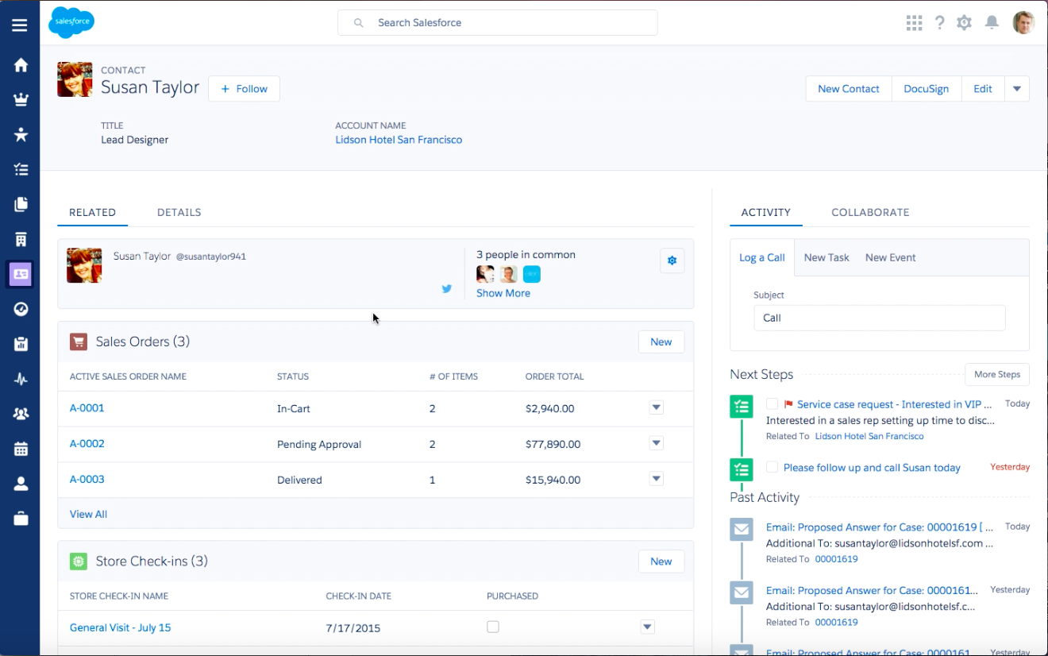

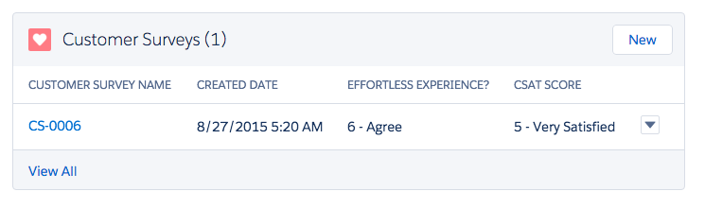

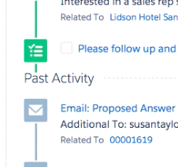
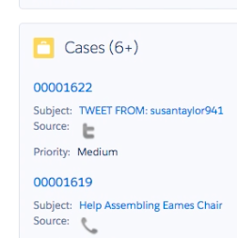
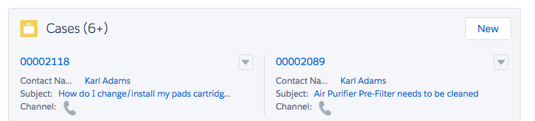

Market & Sell Better with Complete Customer View and Service Data
Access case history to know customer health and status
Managers can view business health across sales and service
Accelerate direct and partner sales with visibility into service records
Notes:
One great way to bring that alignment is giving sales teams visibility into the service data. I don’t know about you, but if you’ve ever walked into a customer meeting, expecting to have a great conversation about a sales opportunity, only to be blindsided by complaints about an unresolved case, you know that’s no fun [insert personal story, NOT from Salesforce]. Imagine reps having that knowledge before the meeting, being able to help resolve the case beforehand? And for sales managers, knowing the health of your team’s accounts gives you much better insight into your renewals and forecasting. If you’re hearing a deal will close this quarter, but you see it’s a red account, you not only know it probably won’t come in, but you can also swarm the account to turn it green.

Slide 24
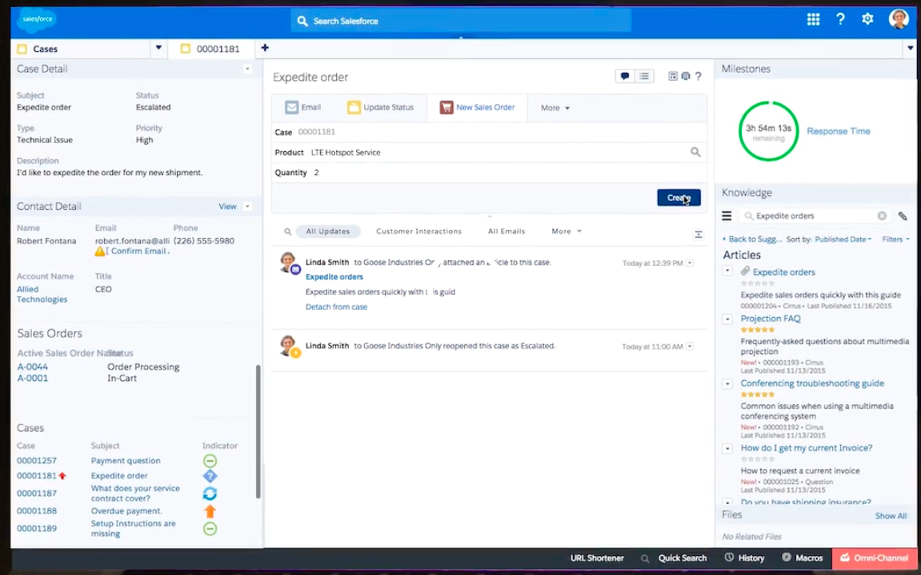
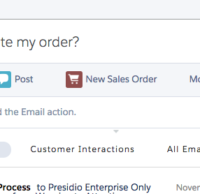

Service Smarter with Sales & Marketing Data
And IOT is knocking doors already !
Identify VIP accounts
Trigger proactive service alerts
Upsell/cross sell directly in the agent console
Notes:
Beyond just identifying VIP clients more quickly, knowing what was sold to a customer can be the first step to solve a problem.

Slide 25
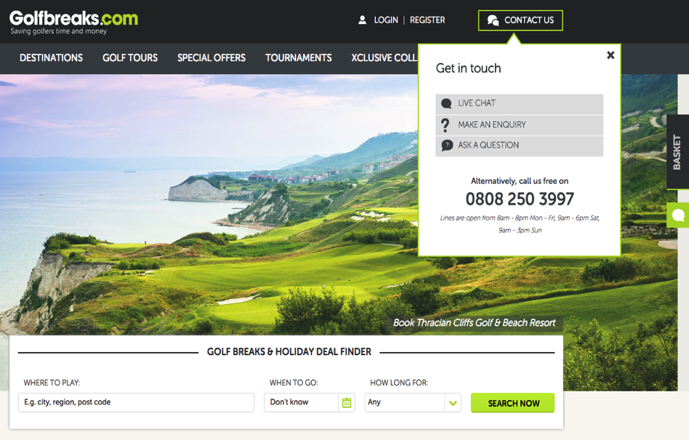
Service Embedded in the Sales Process

Slide 26
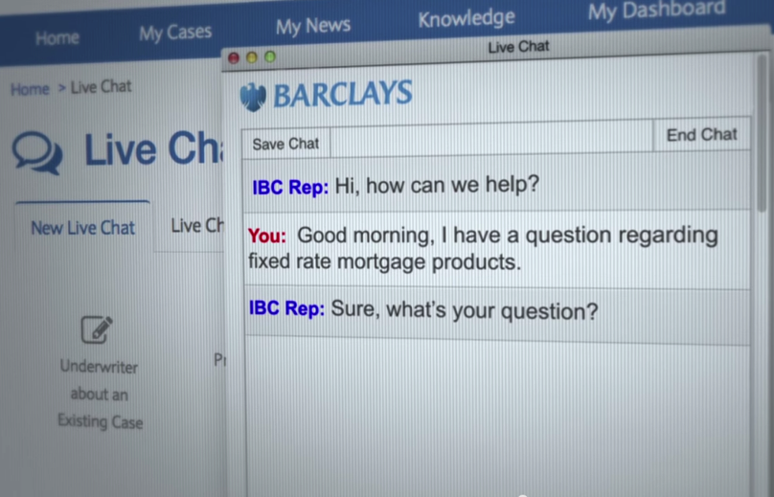
Service Embedded in the Sales Process

Slide 27
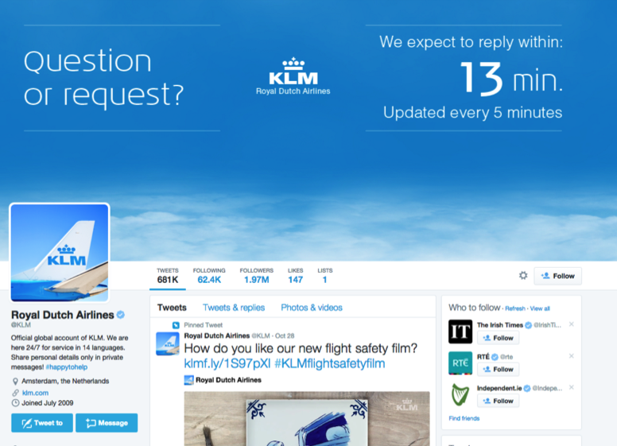
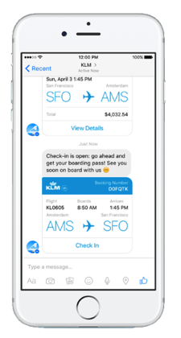
Meeting the Customer on their Terms

Slide 28

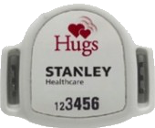
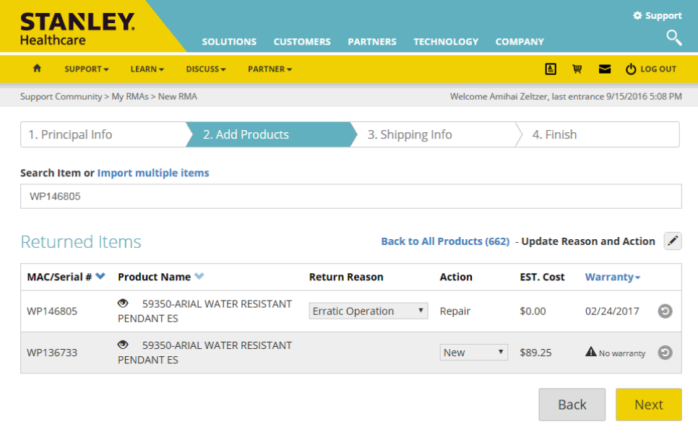
Sales Through Service

Slide 29
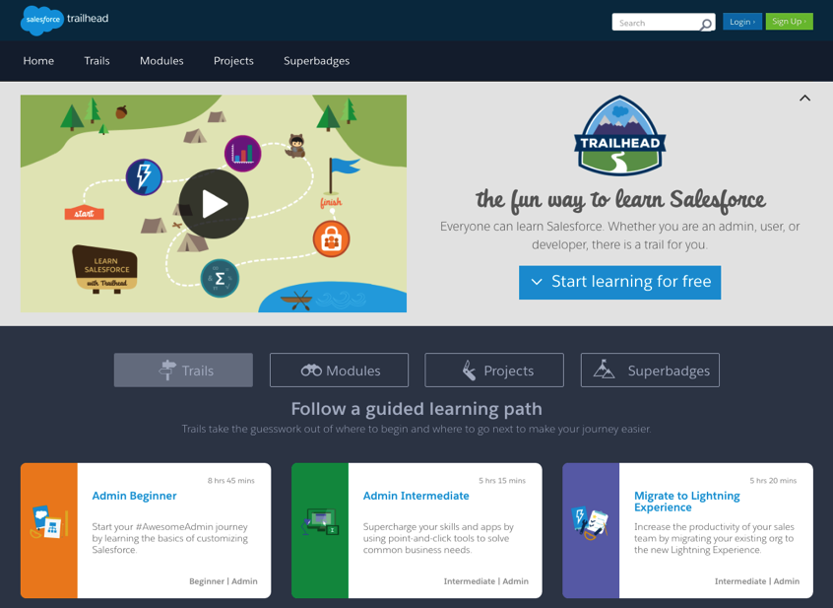
Sales Through Service

Slide 30
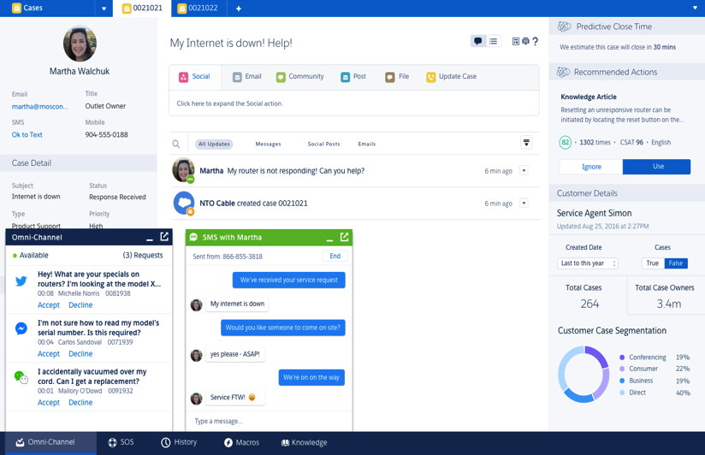
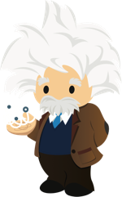
Single View of the Customer

Slide 31

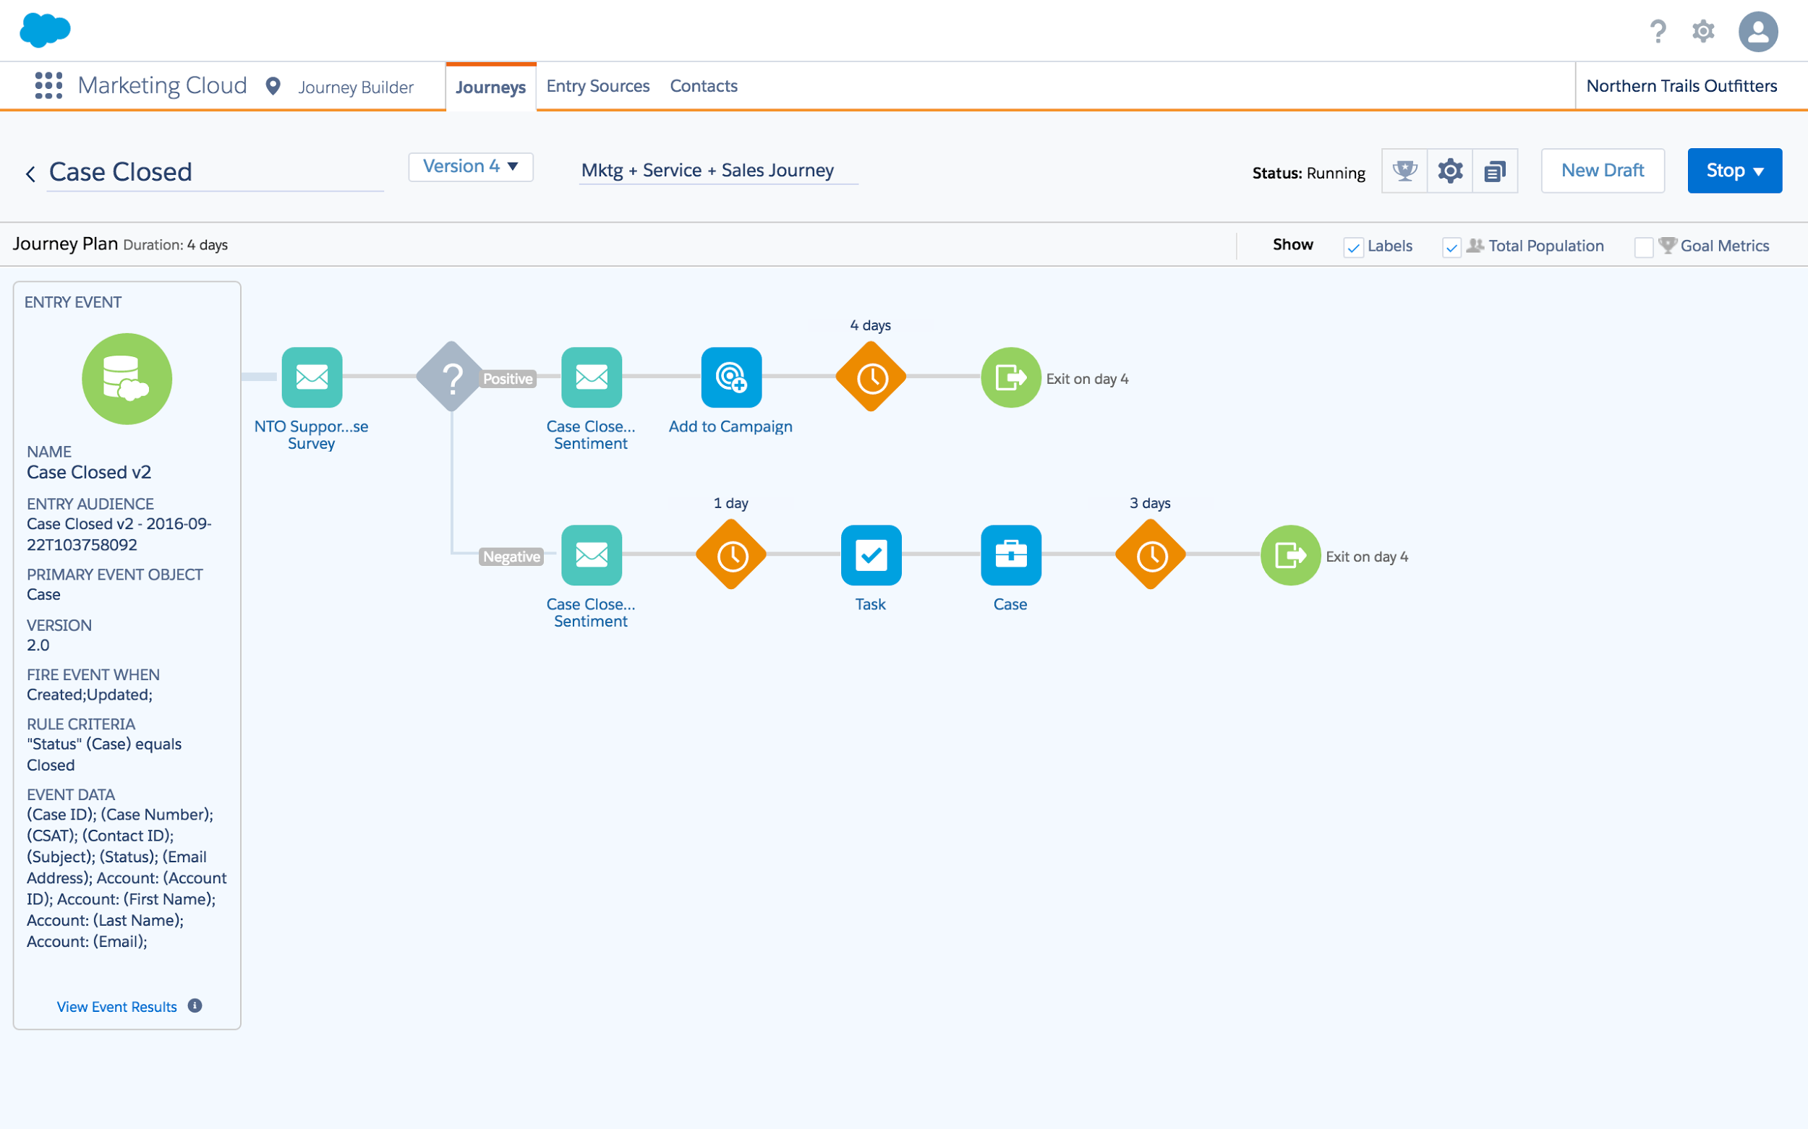

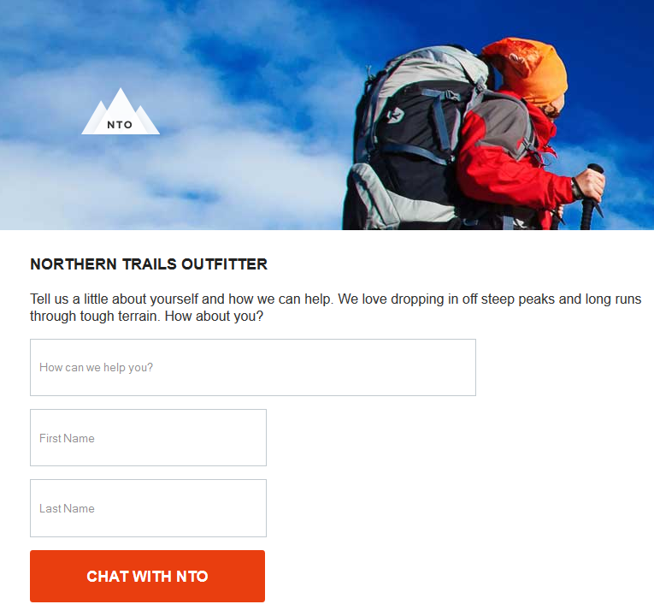

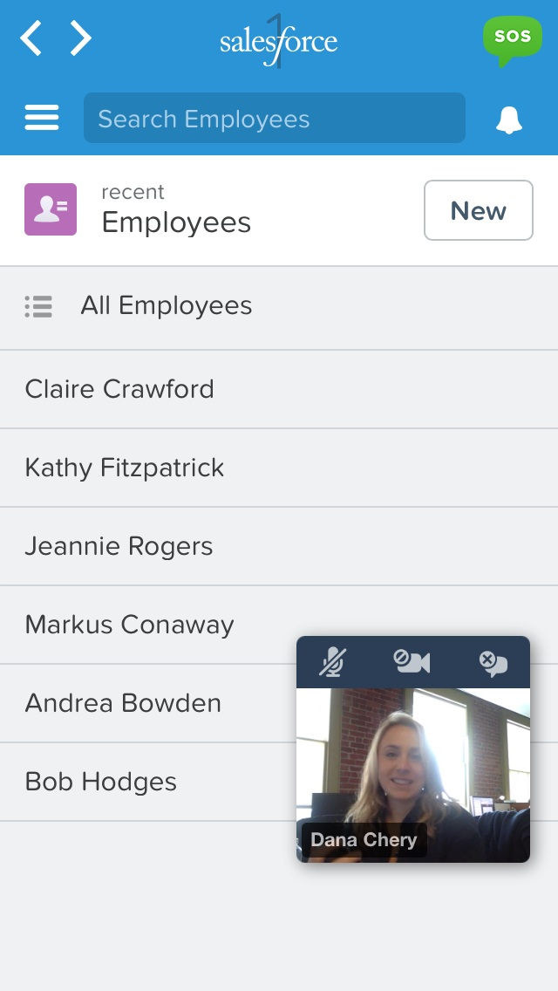
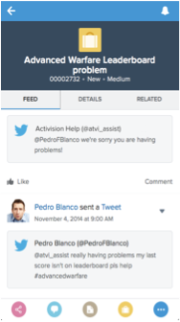
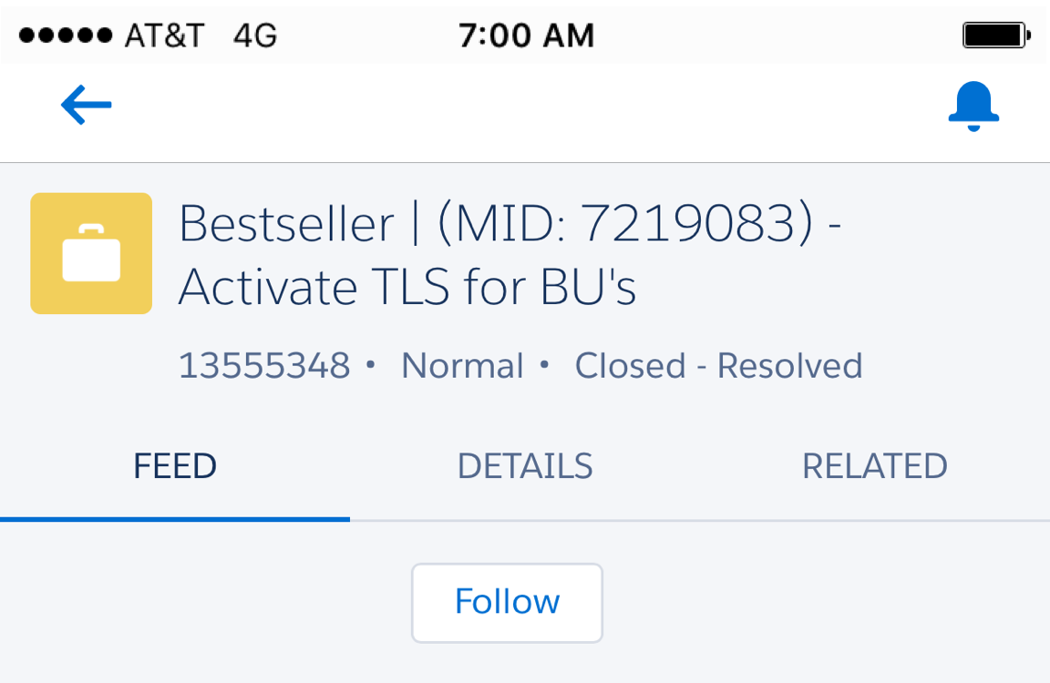
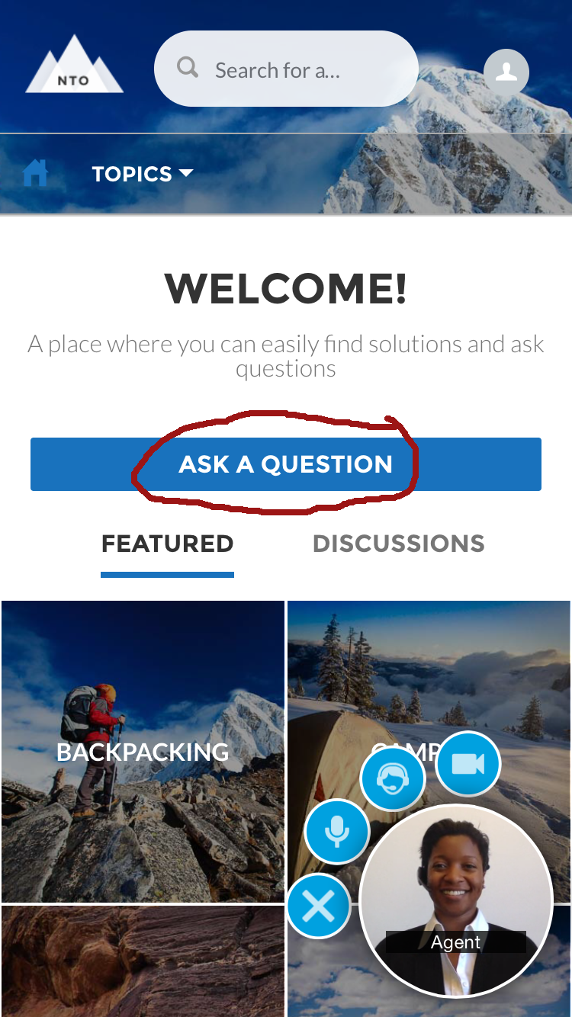

Deliver Personalized Engagement on Every Channel
Seamless customer conversations across all touchpoints
Service Journeys
Connected, omni-channel engagement across traditional and modern channels
Immediately assist with contextual video chat and on-screen annotation
Chat 1-to-1 instantly on any device
Deliver service across every social channel
Automatically send or pause personalized marketing messages after customer service activity
+35%
increase in CSAT
Live Agent & Snap-ins
SOS & Snap-ins
Social Service
Source: Salesforce Customer Relationship Survey conducted 2014-2016 among 10,500+ customers randomly selected. Response sizes per question vary. Percentages are an average.

Slide 32




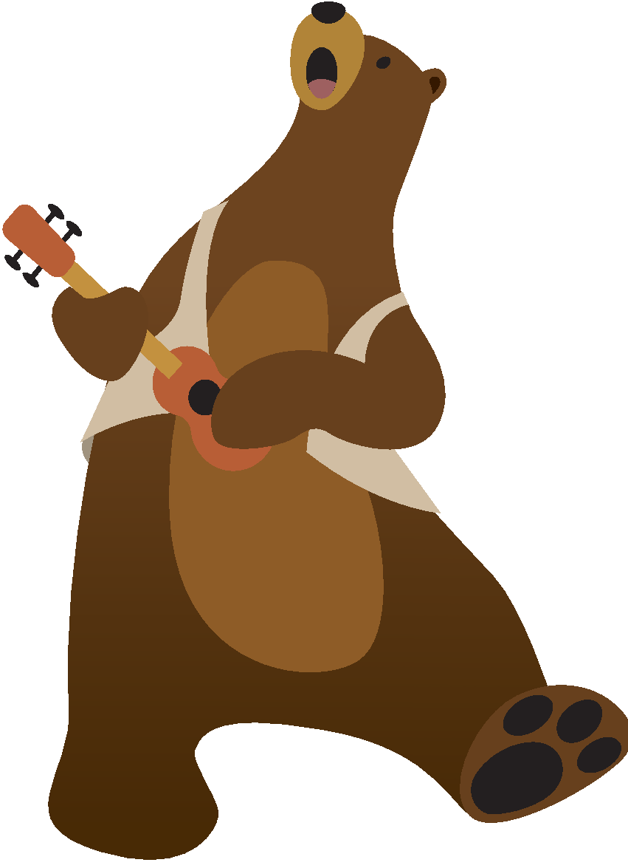
Great Experiences Create Loyal Customers
Align sales and service to grow retention and revenue
1. 80% of sales come from 20% of existing customers
2. Repeat customers spend 33% more than new customers
3. Companies who invest in creating cohesive experiences see a 45% increase in customer retention
Notes:
When companies look at growing their business, the first place they should look is their customer base. Your existing customers are the best source of growth.
For the average company, 20% of their customers represent 80% of their sales, so it’s really important to make sure those super consumers have a great experience and stay customers.
Also, repeat customers spend about 33% more per transaction than new customers. That great to know as you develop your sales strategy, but those customers won’t buy more, and won’t stay customers if they’re not having exceptional service experiences.
When companies invest in customer experience, they see a 45% increase in customer retention. That’s why it’s so important to align your sales and services—you need to make sure you’re retaining those customers to be able to reap the sales benefits.
[Data sourced from here: http://www.cmo.com/articles/2013/7/18/customer_retention.html for bullets 1 & 2. Bullet 3 is original Salesforce research – 2016]

Slide 33


Demo
Notes:
One customer that knows a thing or two about this journey is Tom Caesar who is the MD of Positive Lending Group, who we are lucky to have with us on the webinar today. Now I know you are all clapping right now to welcome him, but it’s a webinar so we can’t hear you.
Tom, thanks for joining us today.
Tell us about Positive Lending Solutions and your original need for a CRM solution?
So how has Salesforce helped increase revenue and boost CSAT?
It’s helped grow your business significantly, and one thing I strongly believe is that Service starts from the first touch point with a potential customer. Let’s talk about the three pillars were are speaking about on this call:
How are you providing personalised service journeys and experiences to your customers?
What about Self-Service - are you doing anything there as yet?
Connected - you said that this is number 1 for PLS. Tell us more about how you have a single view of the customer on platform? What has that meant for your internal staff as well as customers?
Where to next on the Journey – what’s top of mind for you right now?

Slide 34
Notes:
Thank you!

